Slide 1
Chapter Five
Probability and probability distribution
Content of the chapter:
  Introduction and basic concepts
  Random experiments and Counting rules
  Definitions of probability (probability of an event)
  Definition of random variables (discrete and continuous) and probability distributions
  Introduction to expectation and variance of random variable
  Common discrete distributions (binomial and Poisson)
  Common continuous distributions (Normal, t, and chi-square distribution

Slide 2
Introduction Elementary Probability
If an experiment is conducted under homogeneous and similar conditions, we come across two types of situations or phenomena.
Deterministic phenomena :
- the results or the outcome is unique or certain
- the result can be predicted certainly from an experiment performed. Example ‘ohm‘s law voltage, V = I*R, Force, F = m *a

Slide 3
Cont’d
2. Non- Deterministic phenomena :
- the results or the outcomes of an experiment are not unique
- but can be one of the several Possible outcomes
Example:
In random tossing of a coin, we are not sure of getting head or tail.
A sex of new born baby may be male or female

Slide 4
Cont’d
Probability: can be defined as a measure of the likelihood that a particular event will occur or it is a science of decision making with calculated risk in face of uncertainty
It is general concept can be defined as the chance of an event occurring.
Probability is the basis of inferential statistics
For example, predictions are based on probability, and hypotheses are tested by using probability.

Slide 5
Definitions of some probability terms
Experiment: An experiment is any activity that generates outcome(s)
Outcome: is the result of an experiment
Example
Experiment Outcomes
Tossing of a fair coin Head, tail
Rolling a die 1, 2, 3, 4, 5, 6
Selecting an item from a production lot Defective (faulty), non-defective (good)
Introducing a new product Success, failure

Slide 6
Cont’d
Sample space: A sample space is the collection of all possible outcomes of an experiment.
For example, In the roll of a single die, there are six possible outcomes S={1, 2, 3, 4, 5, 6}
Each possible outcome in the sample space is called sample point
Exercise: Find the sample space for the gender of the children if a family has three children.

Slide 7
Cont’d
Event is a subset of the sample space or it is asset containing sample points of a certain sample space under consideration
For examples, getting two heads in the trial of tossing three fair coins simultaneously would be an event.
Elementary event (simple event) is a single possible outcome of an experiment.
Composite (compound) event is an event having two or more elementary events in it

Slide 8
Cont’d
For example, rolling a die sample space = {1,2,3,4,5,6) an event having { 5} is simple event where as having even number={2,4,6} is compound (composite)event.
Mutually exclusive events: Two events are said to be mutually exclusive, if both events cannot occur at the same time as outcome of a single experiment.

Slide 9
Cont’d
Independent Events: Two events A and B are said to be independent events if the occurrence of event A has no influence (bearing) on the occurrence of event B.
Equally likely outcomes: In a certain experiment, if each outcome in the sample space has the same chance to occur, then we say that the outcomes are equally likely outcomes.

Slide 10
Fundamental Principles of Counting Techniques
If the number of possible outcomes in an experiment is small, it is relatively easy to list and count all possible events.
When there are large numbers of possible outcomes an enumeration of cases is often difficult, tedious, or both.
to overcome such problems one can use various counting techniques or rules.

Slide 11
Cont’d
In order to determine the number of outcomes, one can use several rules of counting.
The addition rule, the multiplication rule, permutation rule & combination rule
Addition Rule
If event A can occur in m possible ways and event B can occur in n possible ways, there are m+n possible ways for either event A or event B to occur, but only if there are no events in common between them.
i.e. n (A or B) =n (A)+n(B)-n(A B)

Slide 12
Cont’d
The Multiplication Rule:
If a choice consists of k steps of which the first can be made in n₁ ways, the second can be made in n₂ ways…, the k^{th} can be made in n_{k} ways, then the whole choice can be made in
= n₁*n₂ *…*n_{k}
Example: The digits 0, 1, 2, 3, and 4 are to be used in 4 digit identification card. How many different cards are possible if

Slide 13

Cont…
Solution a)
There are four steps
Selecting the 1st digit, this can be made in 5 ways.
Selecting the 2nd digit, this can be made in 5 ways.
Selecting the 3rd digit, this can be made in 5 ways.
Selecting the 4th digit, this can be made in 5 ways.

Slide 14

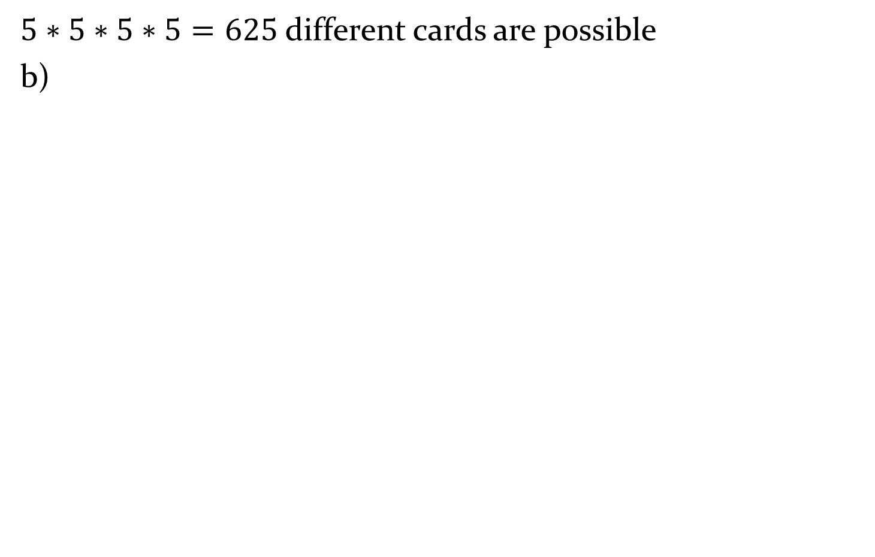
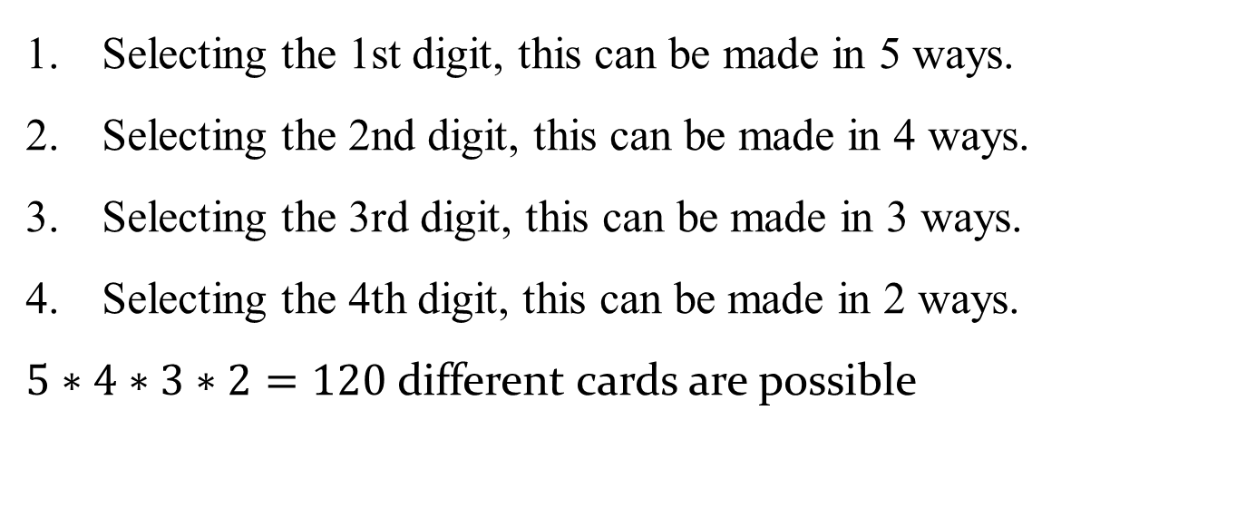
$5∗5∗5∗5=625$different cards are possible
b)
Selecting the 1st digit, this can be made in 5 ways.
Selecting the 2nd digit, this can be made in 4 ways.
Selecting the 3rd digit, this can be made in 3 ways.
Selecting the 4th digit, this can be made in 2 ways.
$5∗4∗3∗2=120$ different cards are possible

Slide 15
Cont’d
Repetitions are permitted.
Repetitions are not permitted.
Permutation
An arrangement of n objects in a specified order is called permutation of the objects.
Permutation Rules:
1. The number of permutations of n distinct objects taken all together is n!
Where n! =n*(n-1)*(n-2)*,…,*2*1.

Slide 16


Cont’d
2. The arrangement of n objects in a specified order using r objects at a time is called the permutation of n objects taken r objects at a time.
3. The number of permutations of n objects in which k₁ are alike, k₂ are alike ---- etc is

Slide 17

Cont’d
4. The arrangement of n objects around a line is
(n-1)!ways.
5. The number of ways of partitioning a set of n things in to k cells where there are n₁ elements in the first cell, n₂ elements in the second cell,…,n_{k} elements in the k^{th} cell is

Slide 18
Cont’d
Suppose we have a letters A,B, C, D
  How many permutations are there taking all the four?
  How many permutations are there two letters at a time?
How many different permutations can be made from the letters in the word “IRRIGATION”?

Slide 19
Combination
A selection of objects without regard to order
Given the letters A, B, C, and D, list the permutations and combinations for selecting two letters.
Solution
The permutations are
AB BA CA DA
AC BC CB DB
AD BD CD DC

Slide 20

Cont’d
In permutations, AB is different from BA. But in combinations, AB is the same as BA since the order of the objects does not matter in combinations.
therefore, if duplicates are removed from a list of permutations, what is left is a list of combinations, as shown.

Slide 21
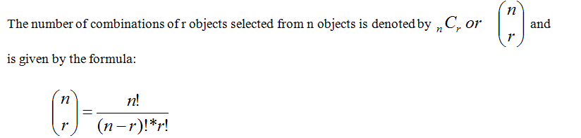
Cont’d
Combination Rule

Slide 22
Cont’d
Example:
A newspaper editor has received 8 books to review. He decides that he can use 3 reviews in his newspaper. How many different ways can these 3 reviews be selected?
Among 15 clocks there are two defectives .In how many ways can an inspector chose three of the clocks for inspection so that:
  There is no restriction.
  None of the defective clock is included.
  Only one of the defective clocks is included.
  Two of the defective clock is included.

Slide 23
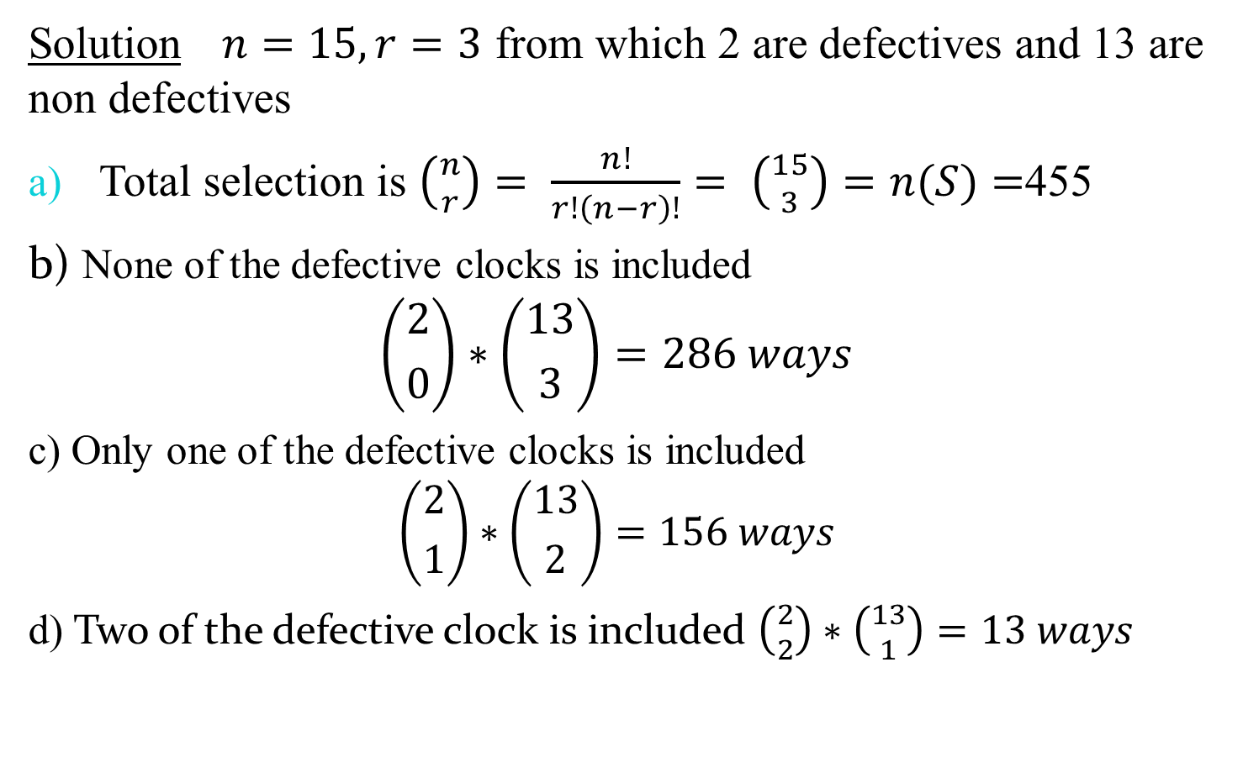
Solution$n=15, r=3$ from which 2 are defectives and 13 are non defectives
Total selection is $\left({n \atop r}\right)= \frac{n!}{r!\left(n−r\right)!}= \left({15 \atop 3}\right)=n(S)=$455
b) None of the defective clocks is included
$$\left({2 \atop 0}\right)∗\left({13 \atop 3}\right)=286 ways$$
  c) Only one of the defective clocks is included
  $$\left({2 \atop 1}\right)∗\left({13 \atop 2}\right)=156 ways$$
  d) Two of the defective clock is included $\left({2 \atop 2}\right)∗\left({13 \atop 1}\right)=13 ways$

Slide 24
Approaches to measuring Probability
There are four different conceptual approaches to the study of probability theory.
These are:
The classical approach.
The frequentist approach.
The axiomatic approach.
The subjective approach.

Slide 25
Cont’d
The classical or Mathematical Approach
This approach is used when:
All outcomes are equally likely.
Total number of outcome is finite, say N.
Classical probability assumes that all outcomes in the sample space are equally likely to occur.

Slide 26

Cont’d
Definition: If a random experiment with N equally likely outcomes is conducted and out of these N_{A} outcomes are favorable to the event A, then the probability that event A occur is defined as:

Slide 27
Cont’d
Examples:
A fair die is tossed once. What is the probability of getting
  Number 4?
  An odd number?
  An even number?
  Number 9?
A box of 70 candles consists of 45 defective and 25 non defective candles. If 10 of this candles are selected at random, what is the probability
a) All will be defective. b) 6 will be non defective c)All will be non defective

Slide 28
Cont’d
Limitation:
If it is not possible to enumerate all the possible outcomes for an experiment.
If the sample points (outcomes) are not mutually independent.
If the total number of outcomes is infinite.
If each and every outcomes is not equally likely.

Slide 29

Cont’d
The Frequentist Approach
Definition: The probability of an event A is the proportion of outcomes favourable to A in the long run when the experiment is repeated under same condition.
Example: If records show that 60 out of 100,000 bulbs produced are defective. What is the probability of a newly produced bulb to be defective?

Slide 30
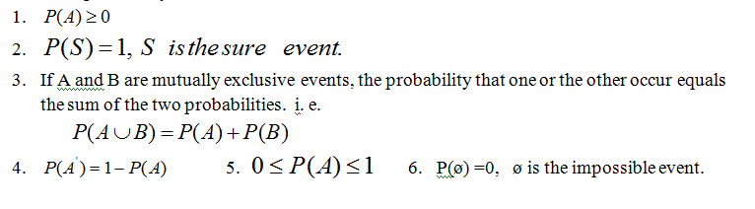
Cont’d
Axiomatic Approach:
Let E be a random experiment
S be a sample space associated with E.
axioms of probability or postulates of probability

Slide 31
Cont’d
Subjective Approach
It is always based on some prior body of knowledge.
Hence subjective measures of uncertainty are always conditional on this prior knowledge.
The subjective approach accepts unreservedly that different people (even experts) may have vastly different beliefs about the uncertainty of the same event.
Example , a sportswriter may say that there is a 75% probability that the St. George will win the Ethio-league next year.

Slide 32
Conditional probability and Independency
Conditional Events: If the occurrence of one event has an effect on the next occurrence of the other event then the two events are conditional or dependant events.
Conditional probability of an event:
The conditional probability of an event A given that B has already occurred, denoted by P(A/B).
Since A is known to have occurred, it becomes the new sample space replacing the original sample space.

Slide 33
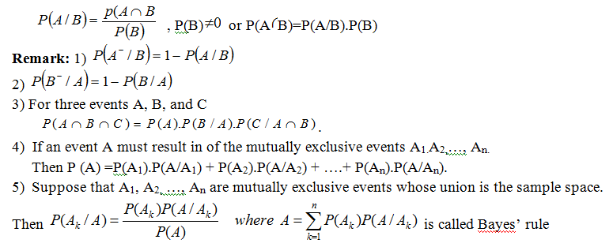
Cont’d
Formula for Conditional Probability

Slide 34
Cont’d
Example: Suppose we have two red and three white balls in a bag
Draw a ball with replacement
Draw a ball without replacement
For a student enrolling at freshman at certain university the probability is 0.25 that he/she will get scholarship and 0.75 that he/she will graduate. If the probability is 0.2 that he/she will get scholarship and will also graduate. What is the probability that a student who get a scholarship graduate?

Slide 35

Cont’d
4. A recent survey asked 100 people if they thought women in the armed forces should be permitted to participate in combat. The results of the survey are shown.
Find these probabilities.
a. The respondent answered yes, given that the respondent was a female.
b. The respondent was a male, given that the respondent answered no.

Slide 36

Cont’d
Probability of Independent Events
Probability of B occurring is not affected by the occurrence or non occurrence of A, then we say that A and B are independent events i.e. P (B/A)=P(B).This is equivalent to
Example; A box contains four black and six white balls. What is the probability of getting two black balls in drawing one after the other under the following conditions?
The first ball drawn is not replaced
The first ball drawn is replaced

Slide 37
Definition of random variables and probability Distribution
A variable was defined as a characteristic or attribute that can assume different values.
A random variable is a variable whose values are determined by chance.
Random variable: - is numerical valued function defined on the sample space.
It assigns a real number for each element of the sample space.

Slide 38
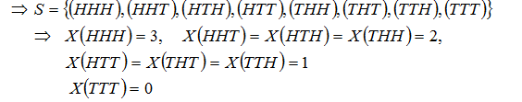
Cont’d
Example: Consider an experiment of tossed a fair of coin three times. Let the random variable X be the number of heads in three tosses, then find X?
X = {0, 1, 2, 3}

Slide 39
Cont’d
Random variables are of two types:
Discrete random variable: are variables which can assume only a specific number of values. They have values that can be counted
Examples:
• Toss a coin n time and count the number of heads.
• Number of children in a family.
• Number of car accidents per week.
• Number of defective items in a given company.
• Number of bacteria per two cubic centimeter of water.

Slide 40
Cont’d
II. Continuous random variable: are variables that can assume all values between any two given values.
Examples:
• Height of students at certain college.
• Mark of a student.
• Life time of light bulbs.
• Length of time required to complete a given training.

Slide 41
Cont’d
Probability distribution:-consists of a value a random variable can assume and the corresponding probabilities of the values
or it is a function that assigns probability for each element of random variable.
Probability distribution can be discrete or continues.
Discrete probability distribution:- is a formula, a table, a graph or other devices used to specify all possible values of the discrete random variable(R.V) X along with their respective probabilities.

Slide 42
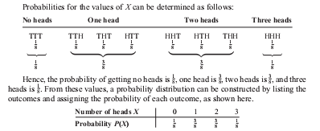
Cont’d
Example: Consider the experiment of tossing a coin three times. Let X be the number of heads. Construct the probability distribution of X.

Slide 43

Cont’d
Exercise: A balanced die is tossed twice, construct a probability distribution if
X is the sum the number of spots in the two trials.
X is the absolute difference of the number of spots in the trials.
Two Requirements for a Probability Distribution

Slide 44
Cont’d
Continuous probability distribution
Definition: a non negative function f(x) is called probability distribution of continuous R.V X if the total area bounded by the curve
the X-axis is 1 and if the sub area under the curve bounded by the curve & X-axis and perpendicularly erected at any points a and b give the probability that X is between a and b.

Slide 45
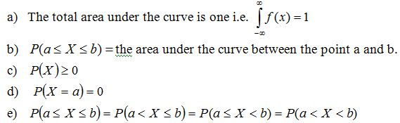
Cont’d
Properties of continuous probability distribution

Slide 46
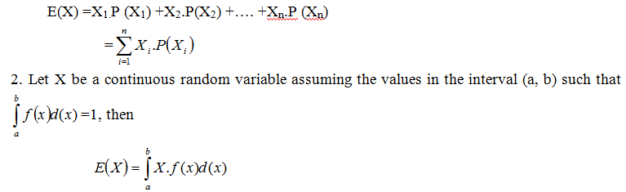
Introduction to expectation
Let a discrete random variable X assume the values X₁, X₂, ….,X_{n} with the probabilities P(X₁), P(X₂), ….,P(X_{n}) respectively. Then the expected value of X, denoted as E(X) is defined as:

Slide 47
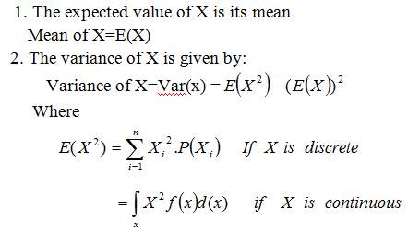
Mean and Variance of a random variable
Let X is given random variable.

Slide 48

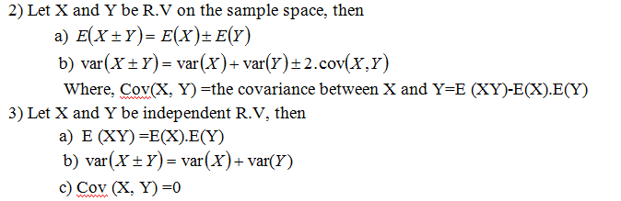
Rule of Expectation
1) Let X be a R.V and k be a real number, then

Slide 49
Cont’d
Example:
What is the expected value and Variance of a random variable X obtained by tossing a coin three times where X is the number of heads?

Slide 50
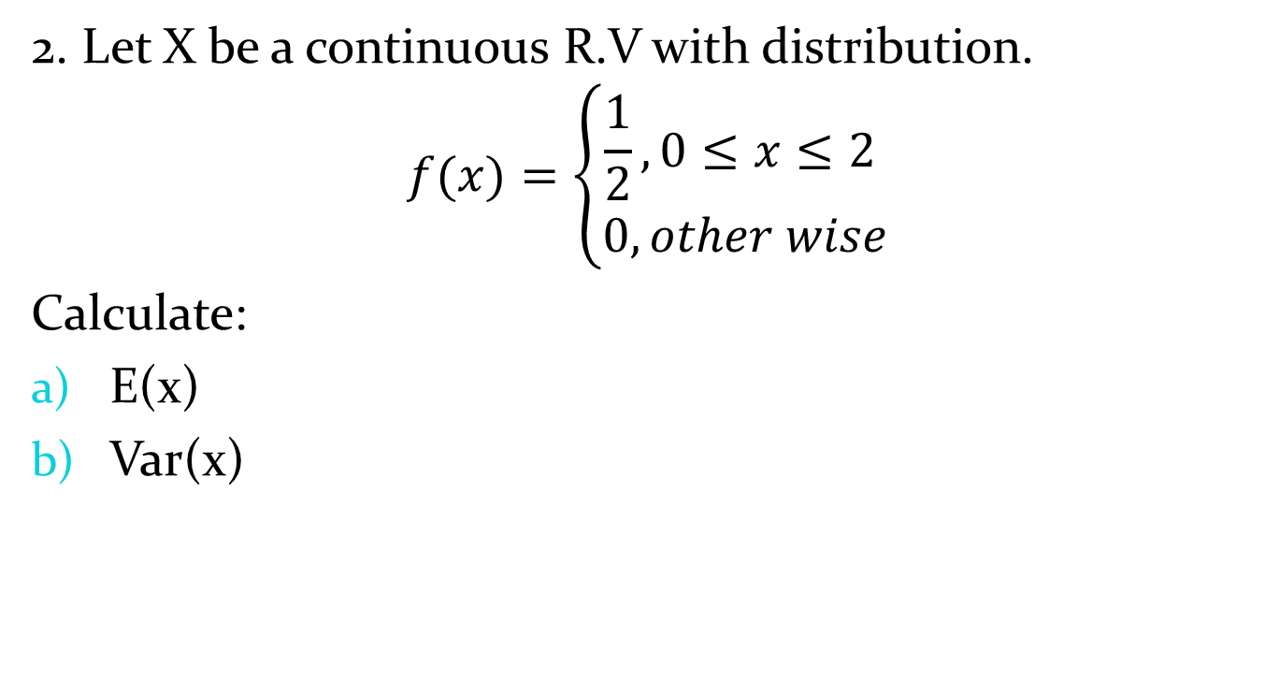
2. Let X be a continuous R.V with distribution.
$$f(x)=\left\{\begin{aligned}\frac{1}{2}, 0≤x≤2 \\ 0, other wise\end{aligned}\right.$$
Calculate:
E(x)
Var(x)

Slide 51
COMMON PROBABILITY DISTRIBUTIONS
Common Discrete Probability Distributions
Binomial Distribution
Assumptions of a binomial distribution.
The experiment consists of n identical trials.
Each trial has only one of the two possible mutually exclusive outcomes, success or a failure.
The probability of each outcome does not change from trial to trial, and
The trials are independent, thus we must sample with replacement.

Slide 52
Cont’d
Many types of probability problems have only two outcomes or can be reduced to two outcomes.
Example: when a coin is tossed, it can land heads or tails.
When a baby is born, it will be either male or female.
In a basketball game, a team either wins or loses.
A true/false item can be answered in only two ways, true or false.
A medical treatment can be classified as effective
or ineffective, depending on the results.

Slide 53

Cont’d
Definition: The outcomes of the binomial experiment and the corresponding probabilities of these outcomes are called Binomial Distribution.
Let p=probability of success q= 1-p=probability of failure on any given trials
Then the probability getting x success in n trials becomes

Slide 54
Cont’d
Remark: If X is a binomial random variable with parameters n and p then
E(X)=np and var(X)=npq
Examples: What is the probability of getting three heads by tossing a fair coin four times?
A survey found that one out of five Ethiopians say he or she has visited a doctor in any given month. If 10 people are selected at random, find the probability that exactly 3 will have visited a doctor last month.

Slide 55
Cont’d
Public Opinion reported that 5% of Ethiopians are afraid of being alone in a house at night. If a random sample of 20 Ethiopians is selected, what is probability.
There are exactly 5 people in the sample who are afraid of being alone at night.
There are at most 3 people in the sample who are afraid of being alone at night.
There are at least 3 people in the sample who are afraid of being alone at night.

Slide 56
The Poisson Distribution
If n is large and p is small and when the independent variables occur over a period of time is called the Poisson distribution.
It depends only on the average number of occurrences per unit time of space.
It is used as a distribution of rare events, such as:
Number of misprints, Natural disasters like earth quake, Accidents, Hereditary, Arrivals, Number of misprints per page etc…

Slide 57
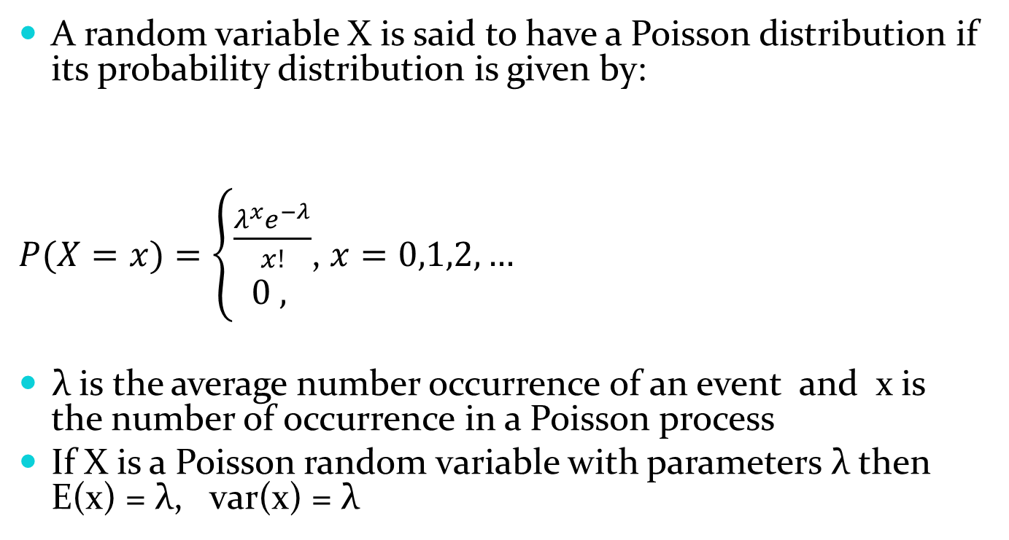
Cont’d
A random variable X is said to have a Poisson distribution if its probability distribution is given by:
$P(X=x)=\left\{\begin{aligned}\frac{λ^{x}e^{−λ}}{x!} \\ 0 , \end{aligned}\right.$, $x=0,1,2,…$
λ is the average number occurrence of an event and x is the number of occurrence in a Poisson process
If X is a Poisson random variable with parameters λ then E(x) = λ, var(x) = λ

Slide 58
Cont’d
Examples:
If 1.6 accidents can be expected an intersection on any given day, what is the probability that there will be 3 accidents on any given day?
On the average, five smokers pass a certain street corners every ten minutes, what is the probability that during a given 10minutes the number of smokers passing will be
  6 or fewer , 7 or more , exactly 8

Slide 59
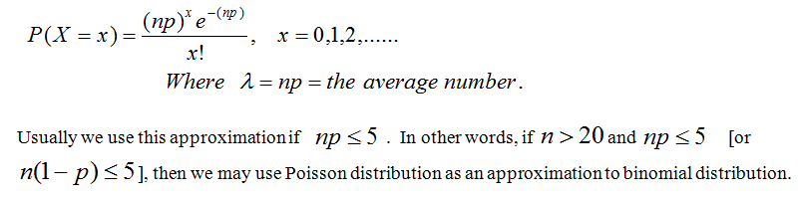
Cont’d
Note: The Poisson probability distribution provides a close approximation to the binomial probability distribution when n is large and p is quite small or quite large with .

Slide 60

Common Continuous Probability Distributions
Normal Distribution
A random variable X is said to have a normal distribution if its probability density function is given by

Slide 61
Properties of Normal Distribution:
A normal distribution curve is bell-shaped.
The mean, median, and mode are equal and are located at the center of the distribution.
A normal distribution curve is unimodal (i.e., it has only one mode).
The curve is symmetric about the mean, which is equivalent to saying that its shape is the same on both sides of a vertical line passing through the center.
The curve is continuous; that is, there are no gaps or holes. For each value of X, there is a corresponding value of Y.

Slide 62
Cont’d
The curve never touches the x axis. Theoretically, no matter how far in either direction the curve extends, it never meets the x axis—but it gets increasingly closer.
The total area under a normal distribution curve is equal to 1.00, or 100%.
The area under the part of a normal curve that lies within 1 standard deviation of the mean is approximately 0.68, or 68%; within 2 standard deviations, about 0.95, or 95%; and within 3 standard deviations, about 0.997, or 99.7%.

Slide 63

Cont’d
Note: To facilitate the use of normal distribution, the following distribution known as the standard normal distribution was derived by using the transformation
Areas under the standard normal distribution curve have been tabulated in various ways.
The most common ones are the areas between Z=0 and a positive value of Z.

Slide 64
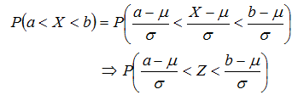
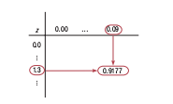
Cont’d
Given a normal distributed random variable X with Mean μ and standard deviation σ
How to read z-table for example, area value for z=1.39

Slide 65
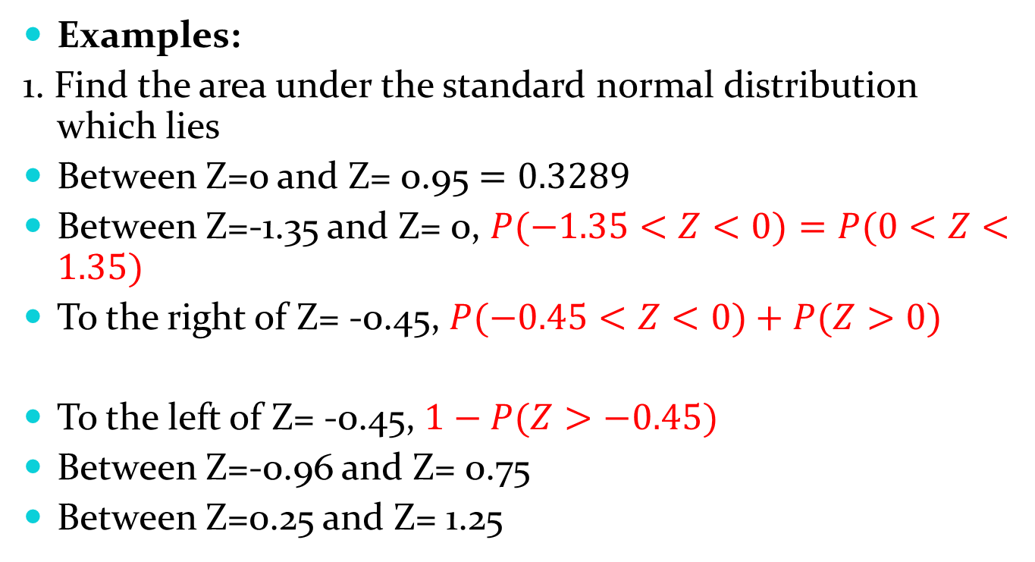
Cont’d
Examples:
1. Find the area under the standard normal distribution which lies
Between Z=0 and Z= 0.95 $=0.3289$
Between Z=-1.35 and Z= 0, $P(−1.35<Z<0)=P(0<Z<1.35)$
To the right of Z= -0.45, $P(−0.45<Z<0)+P(Z>0)$
To the left of Z= -0.45, $1−P(Z>−0.45)$
Between Z=-0.96 and Z= 0.75
Between Z=0.25 and Z= 1.25

Slide 66
Cont’d
2. Find the value of Z if
The normal curve area between 0 and z(positive) is 0.4726
The area to the left of z is 0.9868
3. A random variable X has a normal distribution with mean 80 and standard deviation 4.8. What is the probability that it will take a value
Less than 87.2
Greater than 76.4 c) Between 81.2 and 86.0

Slide 67
Cont’d
A normal distribution has mean 62.4.Find its standard deviation if 20.0% of the area under the normal curve lies to the right of 72.9
A random variable has a normal distribution with standard deviation 5.Find its mean if the probability that the random variable will assume a value less than 52.5 is 0.6915.
Of a large group of men, 5% are less than 60 inches in height and 40% are between 60 & 65 inches. Assuming a normal distribution, find the mean and standard deviation of heights.

Slide 68
Chapter six
Sampling and Sampling Distribution
Sampling: The process or method of sample selection from the population.
Sampling can be done either with replacement or with out replacement.
Sampling unit: the ultimate unit to be sampled or elements of the population to be sampled.
Sample size: The number of sampling units which are selected from a population.
Study Unit: The unit on which information is collected.

Slide 69
Cont’d
Sampling Fraction (Sampling Interval): The ratio between the numbers of units in the sample to the number of units in the source population.
Sampling frame: The list of all the units in the source population from which a sample is to be taken.
Errors in sample survey: sampling and non-sampling error
Sampling Techniques
Random Sampling or probability sampling.

Slide 70
Cont’d
Probability sampling are those in which every item in the population has a known chance, or probability, of being chosen for sample.
It may be noted that the term random sample is not used to describe the data in the sample but the process employed to select the sample.
Probability sampling includes: Simple Random Sampling, Systematic Sampling, Stratified Sampling, Cluster Sampling or Multistage Sampling.

Slide 71
Count…
Non Random Sampling or non probability sampling
Non random sampling is a process of sample selection without the use of randomization.
Non probability sampling includes:
Purposive
Convenience
Quota
Snowball Sampling
Volunteer

Slide 72
CHAPTER 7
ESTIMATION AND HYPOTHESIS TESTING
  Basic Concept of statistical inference
Inference is the process of making interpretations or conclusions from sample data for the totality of the population.
It is only the sample data that is ready for inference.
In statistics there are two ways through which inference can be made.
  Statistical estimation
  Statistical hypothesis testing.

Slide 73
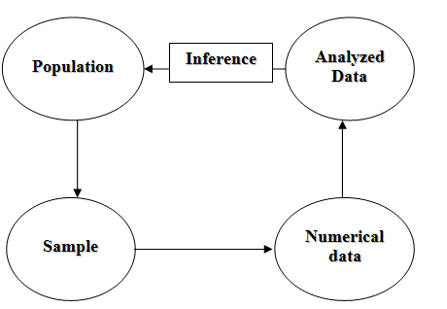
Cont’d
Statistical Estimation

Slide 74
Cont’d
One aspect of inferential statistics is estimation, which is the process of estimating the value of a parameter from information obtained from a sample.
This is one way of making inference about the population parameter where the investigator does not have any prior notion about values or characteristics of the population parameter.
There are two ways estimation.
Point Estimation
It is a procedure that results in a single value as an estimate for a parameter.

Slide 75
Cont’d
Interval estimation
It is the procedure that results in the interval of values as an estimate for a parameter, which is interval that contains the likely values of a parameter.
It deals with identifying the upper and lower limits of a parameter.
Definitions
Confidence Interval: An interval estimate with a specific level of confidence

Slide 76
Cont’d
Confidence Level: The percent of the time the true value will lie in the interval estimate given.
Degrees of Freedom: The number of data values which are allowed to vary once a statistic has been determined.
Estimator: A sample statistic which is used to estimate a population parameter. It must be unbiased, consistent, and relatively efficient. Properties of best estimator should be unbiased, consistent and relatively efficient.

Slide 77
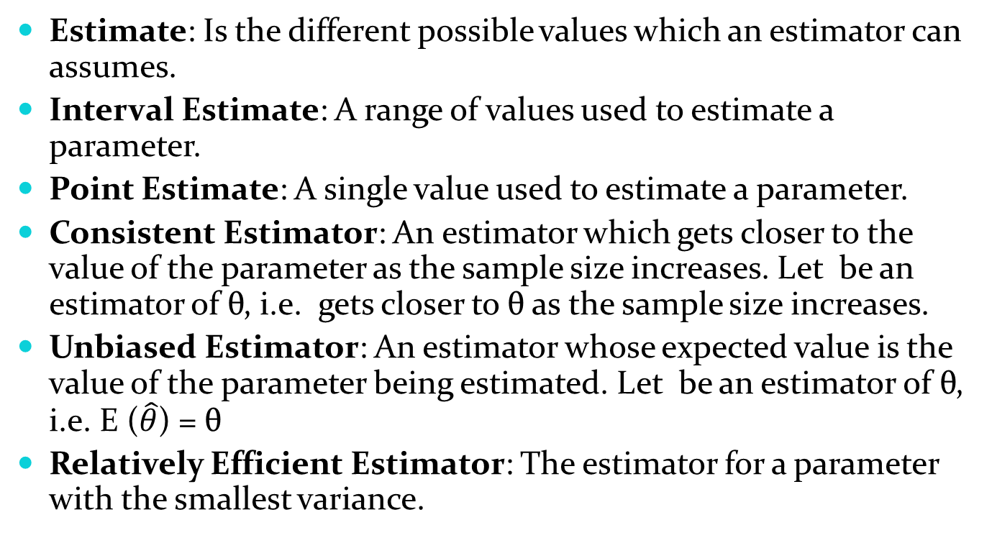
Cont’d
Estimate: Is the different possible values which an estimator can assumes.
Interval Estimate: A range of values used to estimate a parameter.
Point Estimate: A single value used to estimate a parameter.
Consistent Estimator: An estimator which gets closer to the value of the parameter as the sample size increases. Let be an estimator of θ, i.e. gets closer to θ as the sample size increases.
Unbiased Estimator: An estimator whose expected value is the value of the parameter being estimated. Let be an estimator of θ, i.e. E ($\hat{θ}$) = θ
Relatively Efficient Estimator: The estimator for a parameter with the smallest variance.

Slide 78
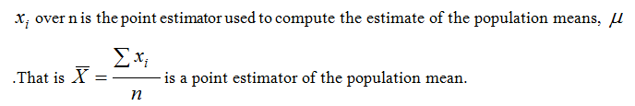
  Estimation (Point estimation and Interval estimation) of population mean
Point Estimation
Another term for statistic is point estimate, since we are estimating the parameter value. A point estimator is the mathematical way we compute the point estimate. For instance, sum of

Slide 79
Confidence interval estimation of the population mean
The confidence level is the probability that the value of the parameter falls within the range specified by the confidence interval surrounding the statistic.
There are different cases to be considered to construct confidence intervals.
Case 1:
If sample size is large or if the population is normal with known variance

Slide 80
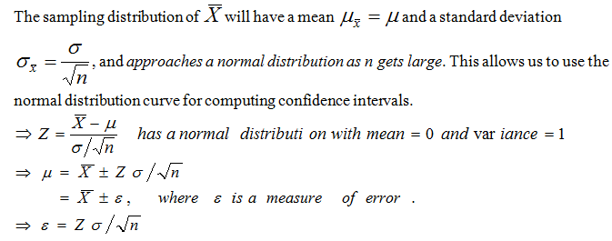
Cont’d
Consider samples of size n drawn from a population with mean µ and st.dev σ

Slide 81
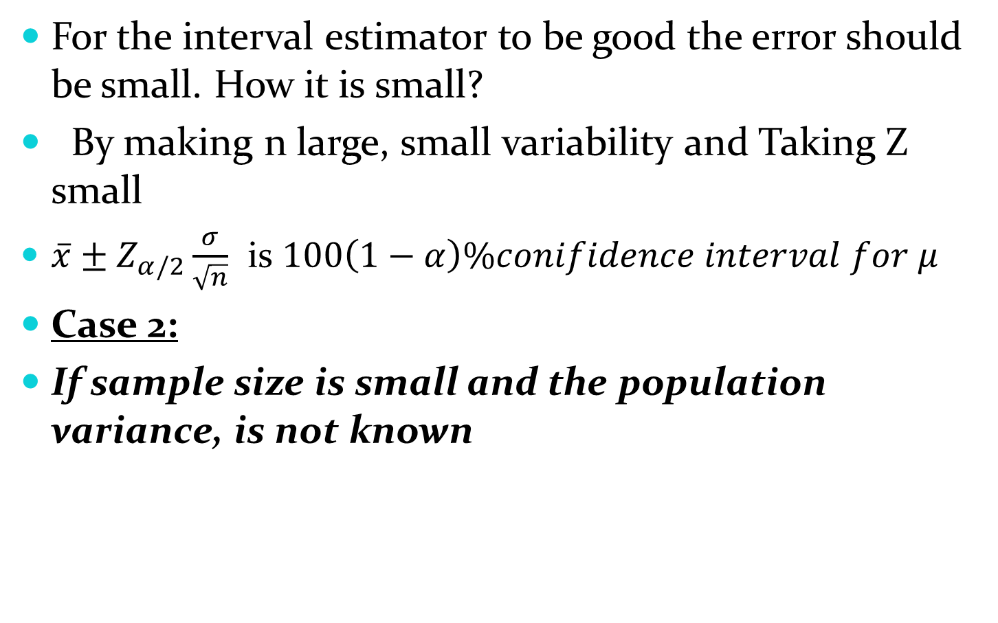
Cont’d
For the interval estimator to be good the error should be small. How it is small?
By making n large, small variability and Taking Z small
$\overline{x}±Z_{α/2}\frac{σ}{\sqrt{n}}$ is $100\left(1−α\right)\%conifidence interval for μ$
Case 2:
If sample size is small and the population variance, is not known

Slide 82
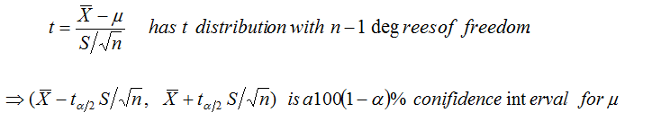
Cont’d
We use t-distribution
Case 3:
If sample size is large and the population variance, is unknown.
We use Z, but in that case we estimate by its point estimator S²

Slide 83
Cont’d
Examples: 1. From a normal sample of size 25 a mean of 32 was found .Given that the population standard deviation is 4.2. Find;
  A 95% confidence interval for the population mean.
  A 99% confidence interval for the population mean.

Slide 84
2. A drug company is testing a new drug which is supposed to reduce blood pressure. From the six people who are used as subjects, it is found that the average drop in blood pressure is 2.28 points, with a standard deviation of .95 points. What is the 95% confidence interval for the mean change in pressure?

Slide 85
Hypothesis Testing
This is also one way of making inference about population parameter, where the investigator has prior notion about the value of the parameter.
    Important concepts in testing a statistical hypothesis
Statistical hypothesis: is an assertion or statement about the population whose plausibility is to be evaluated on the basis of the sample data.
Test statistic: is a statistics whose value serves to determine whether to reject or accept the hypothesis to be tested. It is a random variable.
Statistic test: is a test or procedure used to evaluate a statistical hypothesis and its value depends on sample data.

Slide 86
Cont’d
There are two types of hypothesis:
Null hypothesis:
It is the hypothesis to be tested.
It is the hypothesis of equality or the hypothesis of no difference.
Usually denoted by H₀.
Alternative hypothesis:
It is the hypothesis available when the null hypothesis has to be rejected.

Slide 87
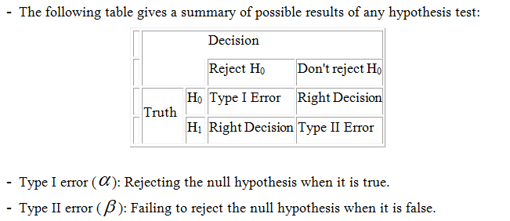
Cont’d
It is the hypothesis of difference.
Usually denoted by H₁ or H_{a}.
Types and size of errors:

Slide 88
    Steps in testing hypothesis:
In hypothesis testing, the researcher must define the population under study, state the particular hypotheses that will be investigated,
give the significance level,
select a sample from the population,
collect the data,
perform the calculations required for the statistical test, and reach a conclusion
In general we follow the following steps:

Slide 89
Cont’d
    The first step in hypothesis testing is to specify the null hypothesis (H₀) and the alternative hypothesis (H₁).
    The next step is to select a significance level , α
    Identify the sampling distribution of the estimator.
    The fourth step is to calculate a statistic analogous to the parameter specified by the null hypothesis.
    Identify the critical region.
    Making decision.
    Summarization of the result.

Slide 90
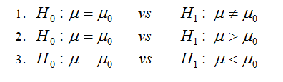
Hypothesis testing about the population mean,µ
Suppose the assumed or hypothesized value of µ is denoted by µ_{o} , then one can formulate two sided (1) and one sided (2 and 3) hypothesis as follows:
1 shows two- tailed test
2 shows right- tailed test and
3 shows left- tailed test

Slide 91

Cont’d
CASES:
Case 1: When sampling is from a normal distribution with σ² known
The relevant test statistic is
After specifying significance level we have the following regions (critical and acceptance) on the standard normal distribution corresponding to the above three hypothesis.

Slide 92
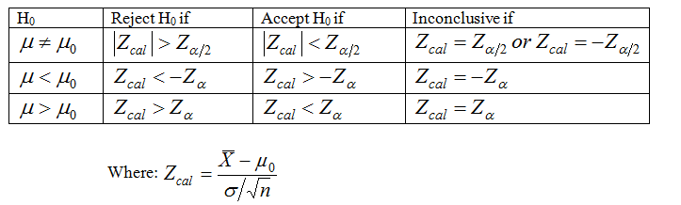
Cont’d
Summary table for decision rule:

Slide 93
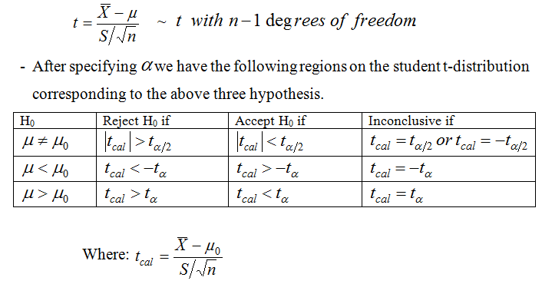
Case 2: When sampling is from a normal distribution with σ² unknown and small sample size
The relevant test statistic is

Slide 94
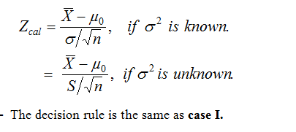
Case3: When sampling is from a non- normally distributed population or a population whose functional form is unknown.
If a sample size is large one can perform a test hypothesis about the mean by using:

Slide 95
Hypothesis-Testing Common Phrases
> <
Is greater than Is less than
Is above Is below
Is higher than Is lower than
Is longer than Is shorter than
Is bigger than Is smaller than
Is increased Is decreased or reduced from
= ≠
Is equal to Is not equal to
Is the same as Is different from
Has not changed from Has changed from
Is the same as Is not the same as

Slide 96
Cont’d
Examples:
Test the hypotheses that the average height content of containers of certain lubricant is 10 liters if the contents of a random sample of 10 containers are 10.2, 9.7, 10.1, 10.3, 10.1, 9.8, 9.9, 10.4, 10.3, and 9.8 liters. Use the 0.01 level of significance and assume that the distribution of contents is normal.

Slide 97
The mean life time of a sample of 16 fluorescent light bulbs produced by a company is computed to be 1570 hours. The population standard deviation is 120 hours. Suppose the hypothesized value for the population mean is 1600 hours.
Can we conclude that the life time of light bulbs is decreasing?

Slide 98
Cont’d
It is known in a pharmacological experiment that rats fed with a particular diet over a certain period gain an average of 40 gms in weight. A new diet was tried on a sample of 20 rats yielding a weight gain of 43 gms with variance 7 gms². Test the hypothesis that the new diet is an improvement assuming normality.
    Read: Hypothesis testing about the population proportion

Slide 99
THANK YOU FOR ATTENTION
GOOD LUCK!!!

